Slide 1
Immersive Python Workshop
Day 2
Python for:
Geospatial Data
Sentiment Analysis
Data Visualization
Managing Python Projects with GitHub

Slide 2
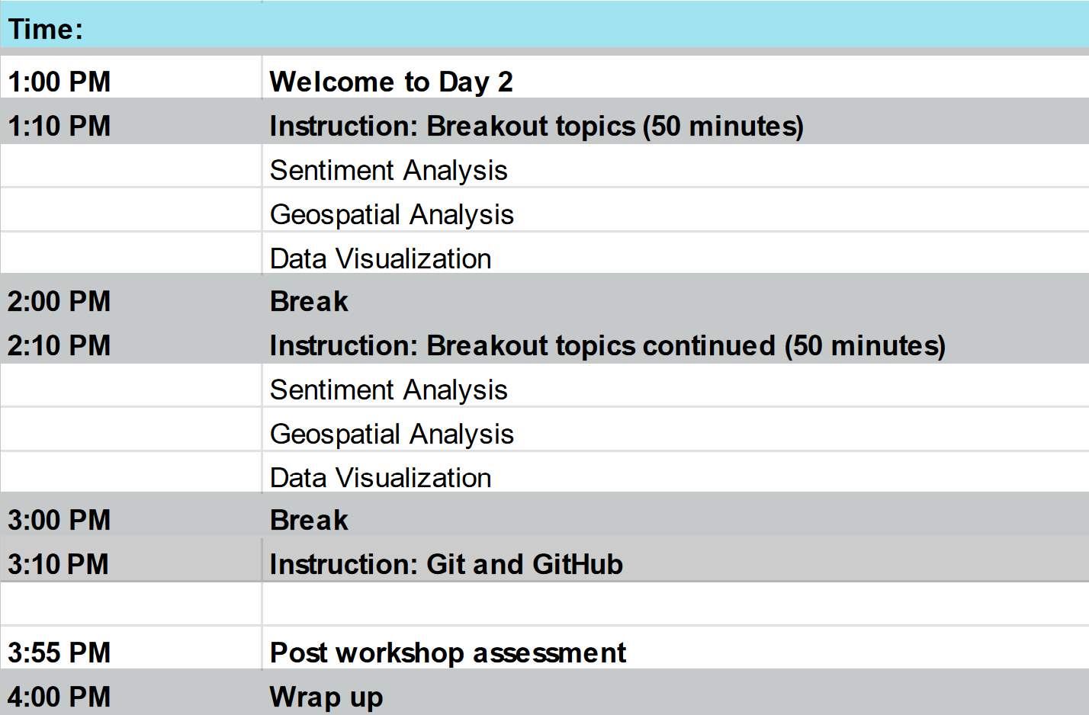
Day 2 Schedule

Slide 3
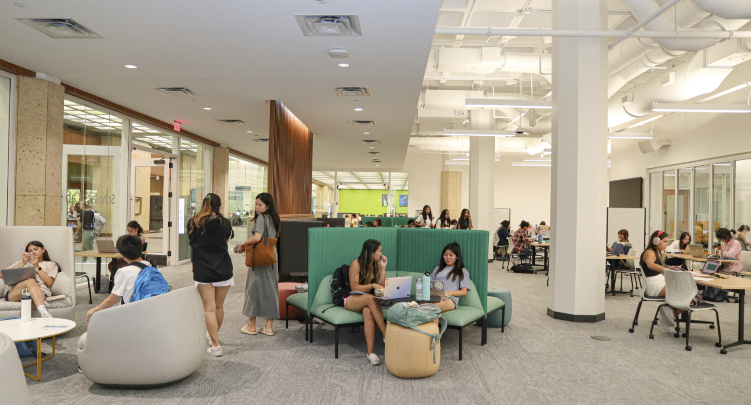
Utilizing the Scholars Lab
Data Lab
Data and Donuts
Digital Humanities Workshops
DH Day
More
Project Rooms
Digital Scholarship related projects
Reservable
Scan Tech Studio
Supports Optical Character Recognition and Handwritten Text Recognition
Scanners and PC
Reservable
Digital Scholarship Consultation
Notes:
We have enabled live captions on Zoom. So long as I remember to turn them on, you should see them, and if they distract you or you need them to look different, you can adjust the display settings individually to your preferences.
Before I move into the last section of pre-workshop logistics and housekeeping items, are there any questions about what we’ve just gone over?

Slide 4
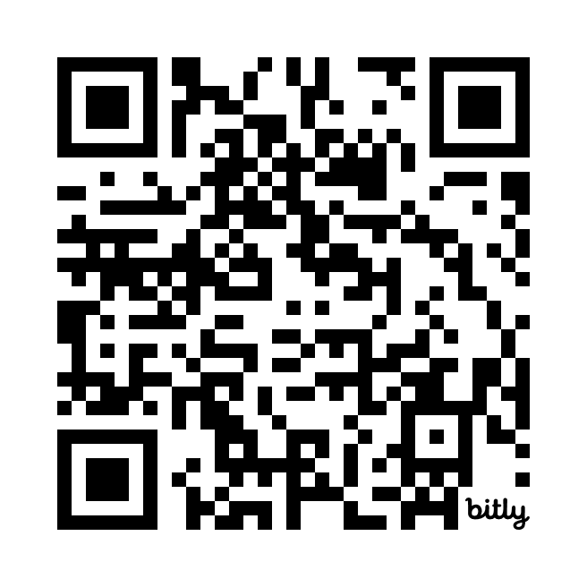
Logistics
Shared notes document (https://bit.ly/ipw-jan2025)
Important URLs will be provided here
Asking questions
Food
Timing of breaks
Bathroom locations
Logging in to the computers
Workshop materials and slides will be posted on GitHub
QR code for shared
notes document
Notes:
The following Zoom features are perhaps familiar to many people by now, however we would like to spotlight some of the zoom features we’re suggesting you may use today. The image shown is a representation of what your zoom screen most likely displays on your device.
Hover your mouse over the bottom of your Zoom window to see the icons.
First note the person icon, highlighted in a red box. Click and open the “Participants” window. If you click next on “More” you should see the option to rename your profile to your preferred name. This can also be done by going to your profile picture in the zoom gallery and clicking on the three ellipses “...” - you can update your profile picture here as well.
2nd, use the chat icon, highlighted in a blue box on this image, to open your chat window. Reminder to type the words “QUESTION” or “HELP” with your comments. Our helpers and hosts will be monitoring the chat. Please type a greeting to test your chat.
Finally, our instructors may be using Zoom reactions during their lesson. This image shows the reactions icon, a smiley face, highlighted in a green box. Click on your reactions icon below our slide, and it should open options like shown in the larger green box. Wave, thumbs up, a green circle with a white check mark for “yes” and a red circle with a white x for “no.”.

Slide 5
Software Installation Support
Python (https://www.python.org/downloads/)
Make sure you can install new Python packages using the Terminal (MacOS) or Command Prompt (Windows)
Try the following command on your PC: python -m pip install pandas
Try the following command on your Mac: python3 -m pip install pandas
VSCode (https://code.visualstudio.com/download)
Create a new file with the extension .py (to designate the file as a Python script)
Try clicking the play/run button in the upper right corner of VSCode to run the script
Git (https://git-scm.com/downloads)
Github Desktop (https://desktop.github.com/download/)
See next slide for troubleshooting common issues

Slide 6
Software Installation Common Issues
Mac
ISSUE: you cannot run a Python script in VS Code
CAUSE: the Python default interpreter path is not set correctly
SOLUTION: In VSCode go to File > Preferences > Settings and search for the Python default interpreter path setting - when you find it, update the the value to the correct Python interpreter path. If you don’t know the path to the interpreter, open your Terminal, type python3, import sys, and the run sys.executable
PC
ISSUE: trying to run python in the command prompt opens the Windows Store
CAUSE: the directory containing your Python interpreter is not correctly listed in your system Environment Variables’ path listing
SOLUTION: use the full path to your Python interpreter in the Command Prompt. If you don’t know the path to the interpreter search on your file system until you find out where it is installed and then use the full path wrapped in quotation marks in the command prompt (e.g. use 'C:\\Program Files\\python\\python.exe' but note the exact path may be different on your computer)
Helpers can stay past 4pm today to help resolve issues - having everything working by start of Day 2 is important

Slide 7
Track 1
Topic:
Data Visualization
Location:
Data Lab
Instructor:
Michael Shensky
Track 2
Topic:
Sentiment Analysis
Location:
Project Room 5
Instructor:
Ian Goodale
Karina Sanchez
Track 3
Topic:
Geospatial Data
Location:
Project Room 6
Instructor:
Alex Marden

Slide 8
Immersive Python Workshop Day 2 | Git & GitHub

Slide 9
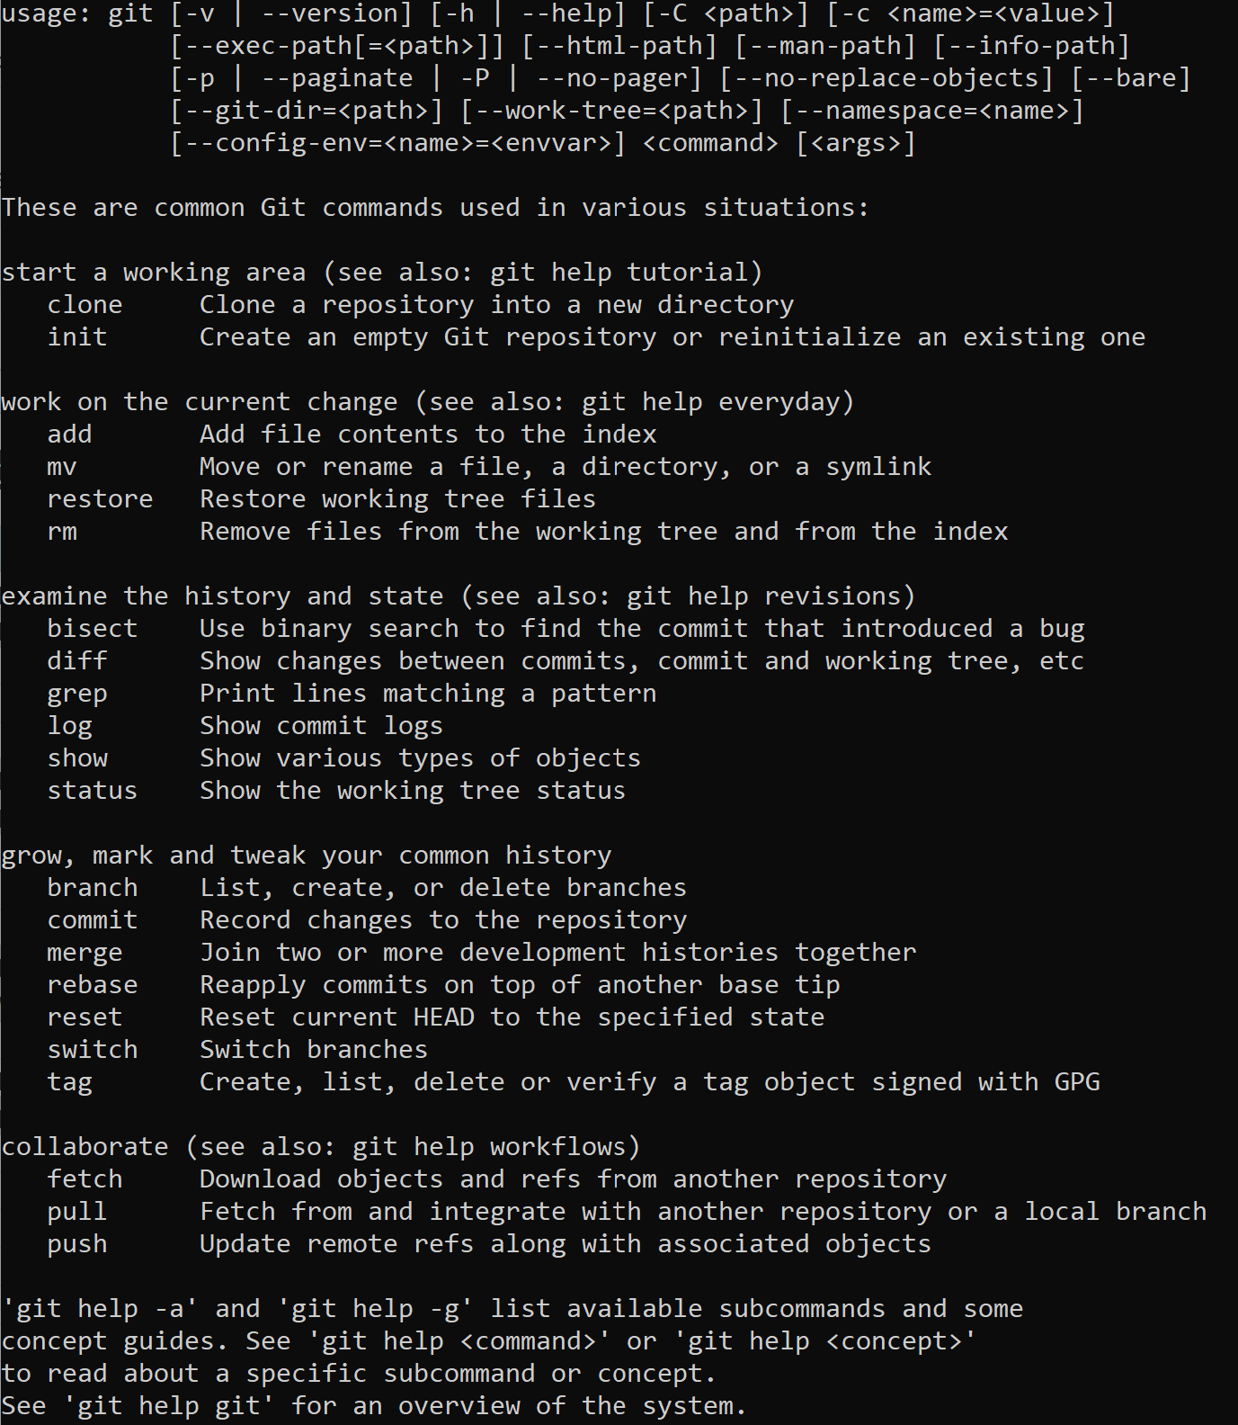
Introduction to Git
https://git-scm.com/downloads
Distributed version control system
Free and open source
Cross platform compatible
Run via Terminal or Command Prompt

Slide 10
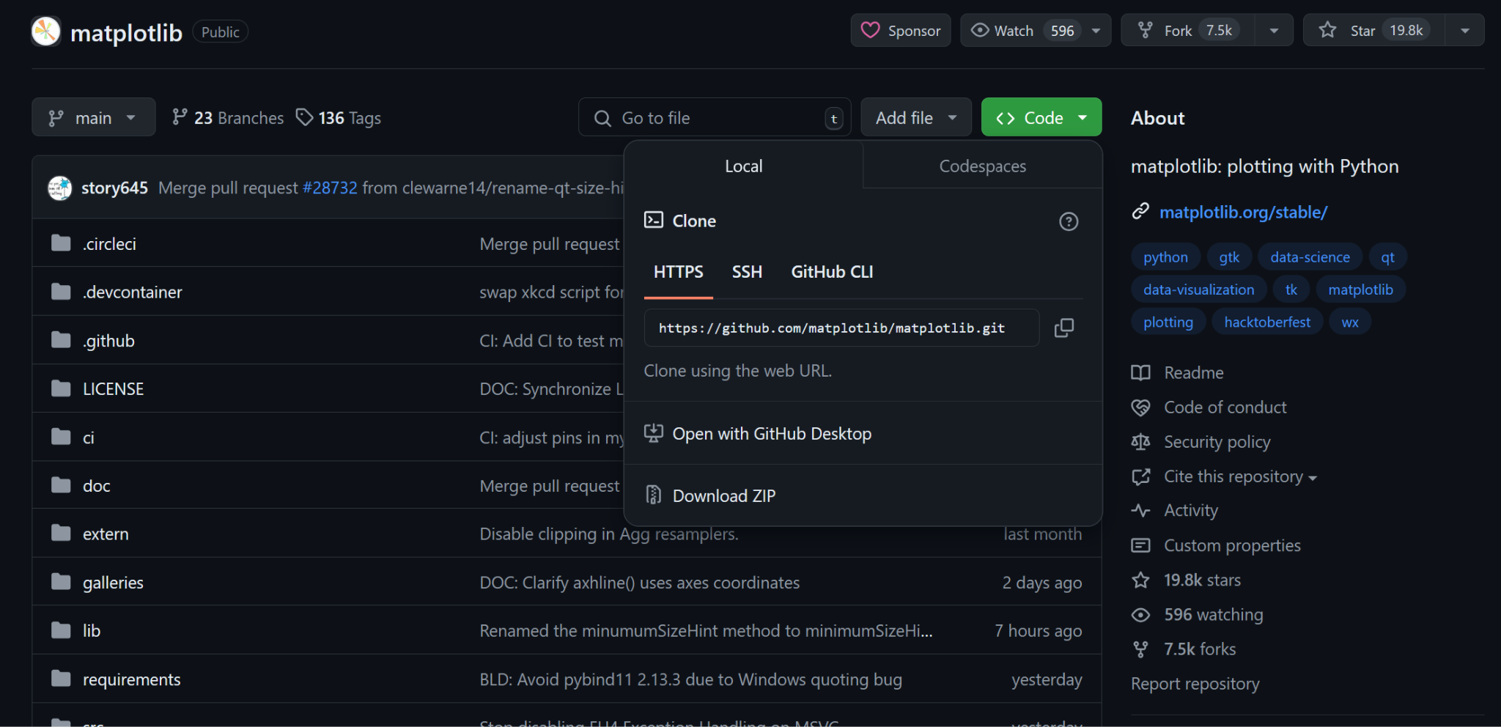
Commonly Used Git CLI Commands
Clone
Init
Add
Commit
Remote
Push
Pull
A detailed overview of all git commands can be found https://training.github.com/downloads/github-git-cheat-sheet/

Slide 11

Introduction to GitHub
GitHub is a great platform for backing up, versioning, collaborating on, and sharing code
It can be a great tool for researchers who want to make their work transparent and replicable
http://github.com vs. http://github.austin.utexas.edu/ (for faculty & staff)
You can use GitHub to publish code for your own projects or to contribute to other software projects for which you are a collaborator or which have been released as open source

Slide 12

Why Push Research Code to GitHub
Get recognition for the coding work that you have done
Share your work with others so that your code can have a greater impact
Make code backups and versioning relatively easy
Potentially benefit from others finding bugs and submitting pull requests for code improvements
Enterprise GitHub and private repositories allow for secure and controlled code management
Help make your research workflows reproducible

Slide 13


GitHub Terminology to Know
Git Open source software used to track and manage versions of files containing text
Repository A container for all of a projects files, they can be open or private
Commit An individual change to a set of files in a repository
Versioning Tracking and saving records of changes to files over time
Pull request Proposed changes to a files in a repository that can be accepted or rejected
ReadMe File A file that defines the content on the repo landing page and provides essential project info
Git Ignore File A file in a git repository that describes files which should not be shared publicly

Slide 14
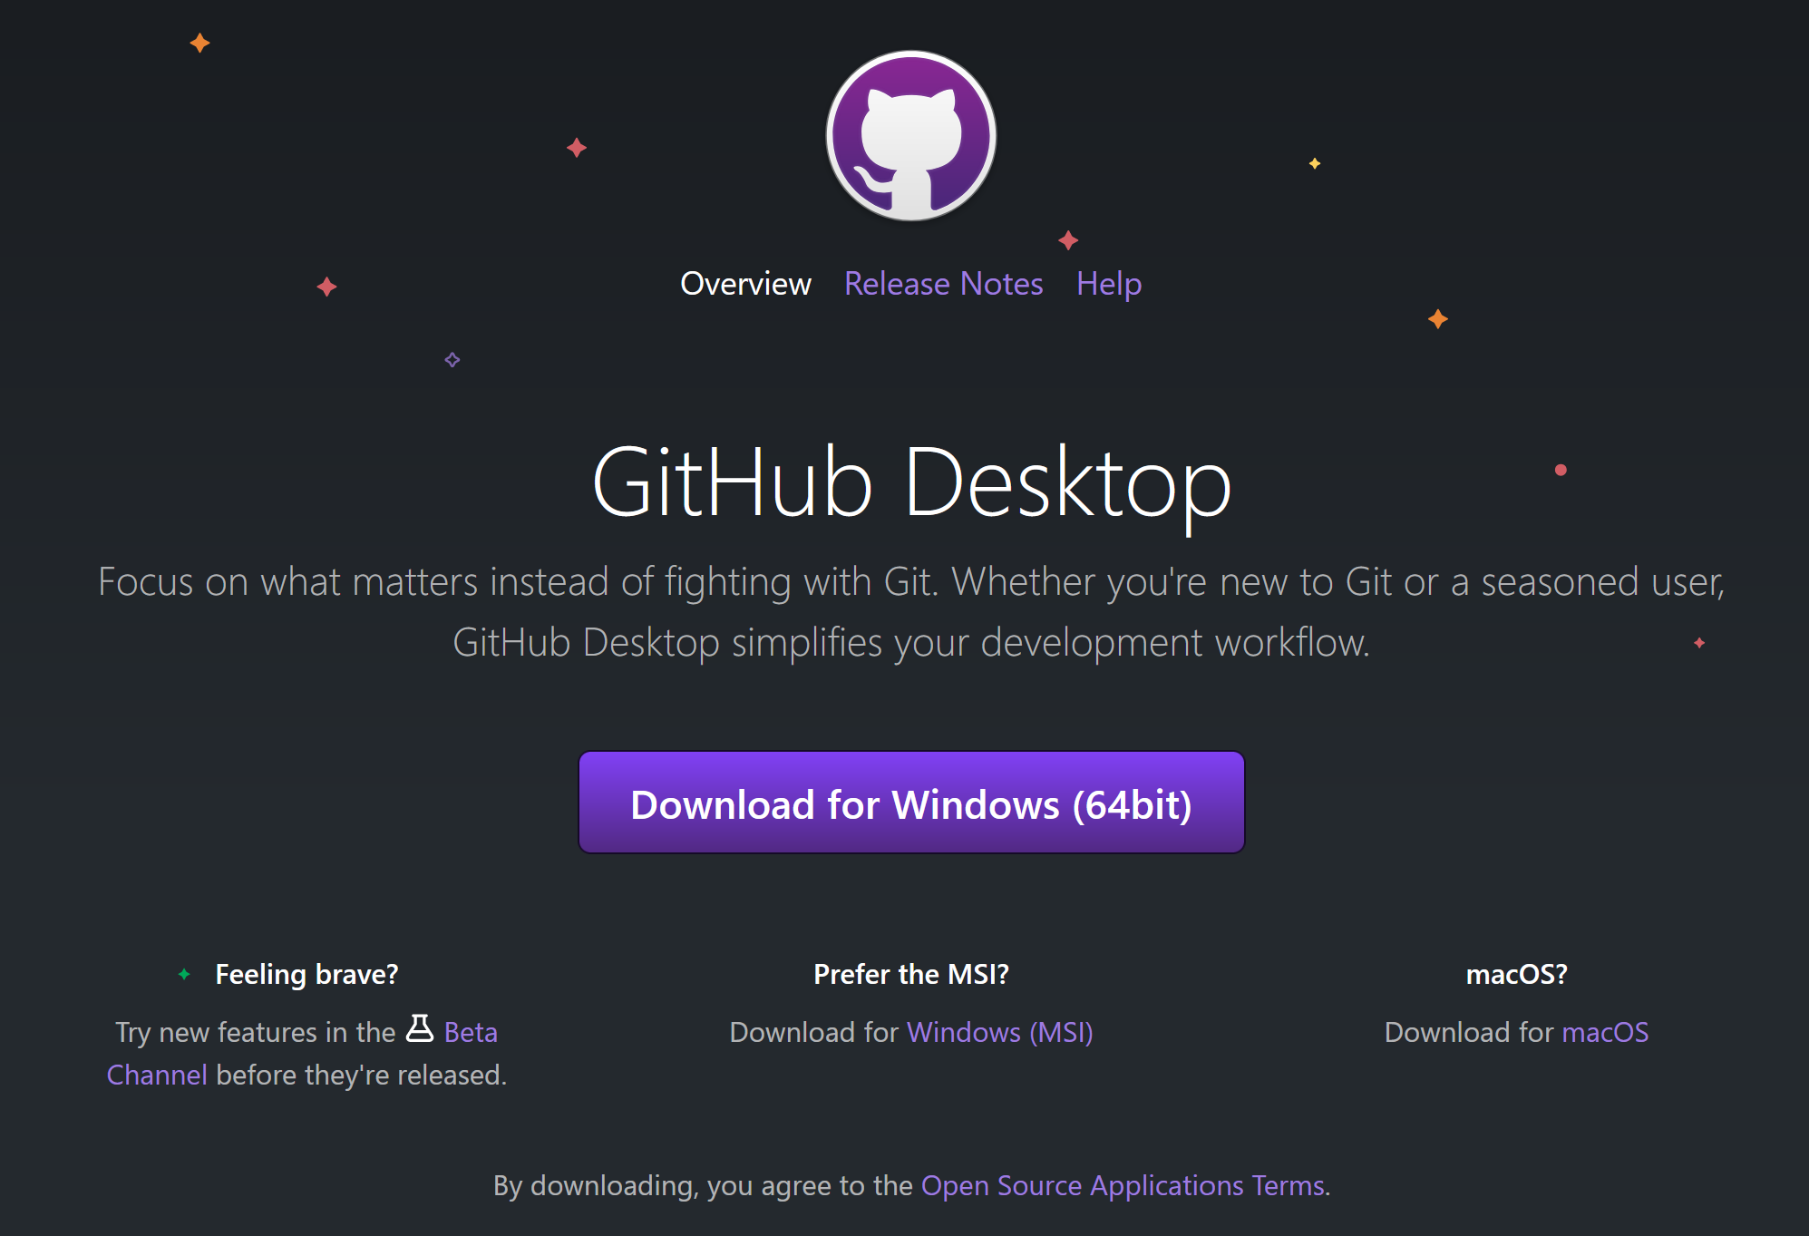
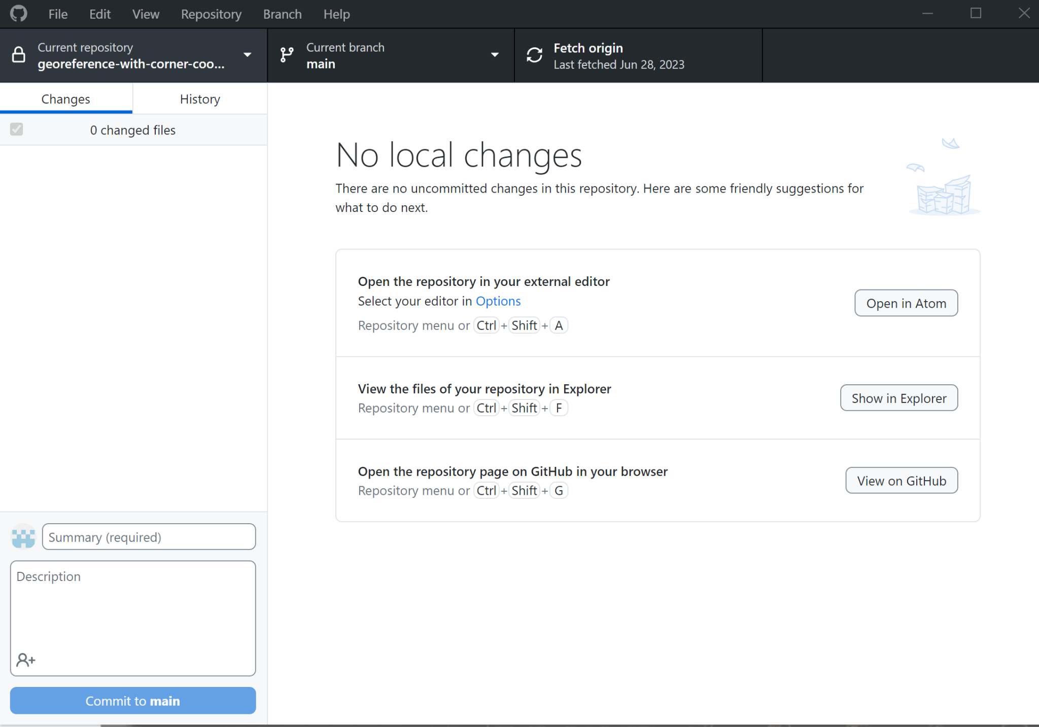
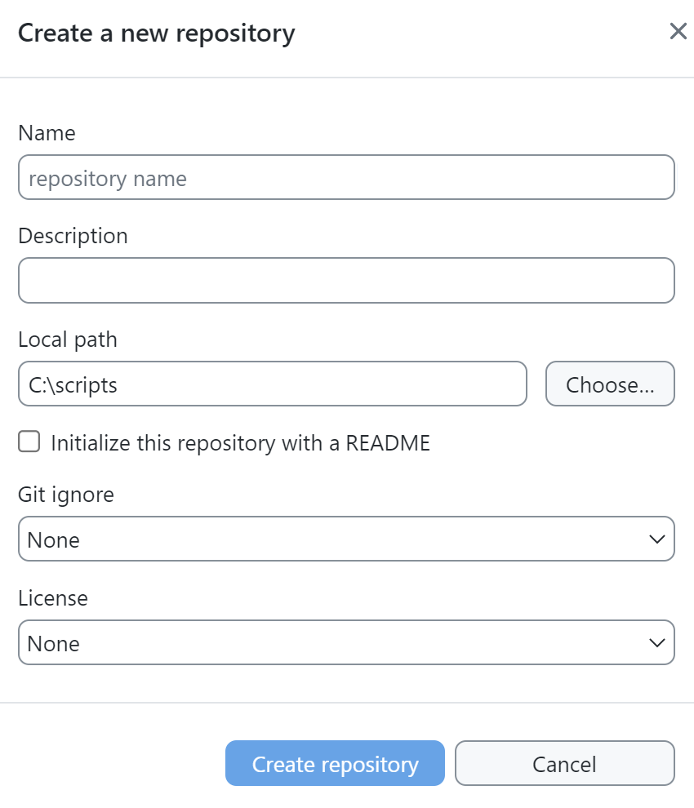
Getting Started with GitHub
Create a GitHub account
Download and install GitHub Desktop (already on lab computers)
Create a new repository in GitHub
Connect GitHub Desktop to your personal GitHub and clone the new repository created in step 3 down to your computer
Copy your Python script file that you created earlier today and past it into the repository on your computer
Make an initial commit using GitHub Desktop
Push the code from your local repository to your GitHub account

Slide 15
Other GitHub Skills to Practice
Edit .gitignore file
Fill out README file
Fork an existing open source repository
Submit a pull request

Slide 16
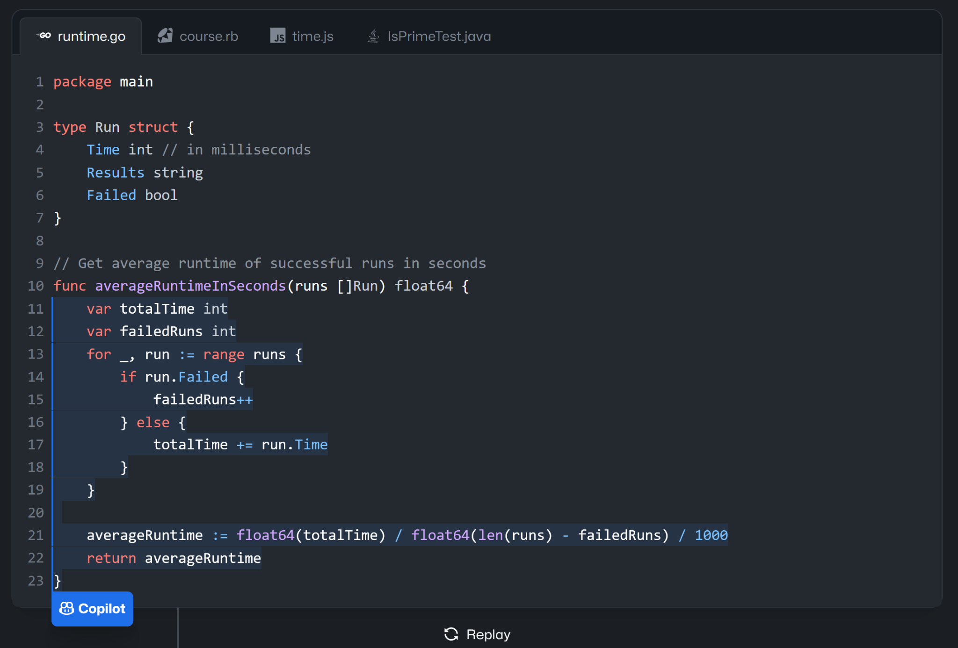
GitHub Copilot
https://github.com/features/copilot
Recently announced free tier with 50 completions per month (link)
Good for help with adding new code snippets within a project
Extension in VS Code can be used for free by students, faculty, & open source project maintainers
https://docs.github.com/en/copilot/managing-copilot/managing-copilot-as-an-individual-subscriber/managing-your-copilot-subscription/getting-free-access-to-copilot-as-a-student-teacher-or-maintainer

Slide 17



Selecting a Software Licensing
If you want others to know how they are permitted to use the code you share on GitHub, you should select a license that clearly defines associated restrictions and obligations
There are many options to choose from, but some like these below are frequently chosen
MIT
BSD 3-Clause
GNU
Apache
Visit https://choosealicense.com/licenses/ for a detailed list of license options
The open source license best practices document on the OSPO site summarizes key considerations

Slide 18





UT Open Source Program Office (UT-OSPO)
The UT Open Source Program Office (UT-OSPO) is a great new resource for developers of research software
Established in 2023 with funding from the Alfred P. Sloan Foundation (Grant Number G-2023-20944)
Director: Angela Newell, Ph.D. (anewell@austin.utexas.edu)
The Office is a partnership between TACC, ITT, the iSchool, & UT Libraries

Slide 19

UT-OSPO Vision
Focus on faculty, post-docs, grad students - helping them interact with the open source communities for the tools that they use.
Engage faculty and students in an open source participation pathway advancing basic use of open source software through contribution, sharing, accepting external contributions, and ultimately developing an ecosystem of related open source projects.
Develop a community of researchers who use, contribute to or develop open source code and a program office that embraces and supports researchers at every step of the pathway from using code to developing software

Slide 20
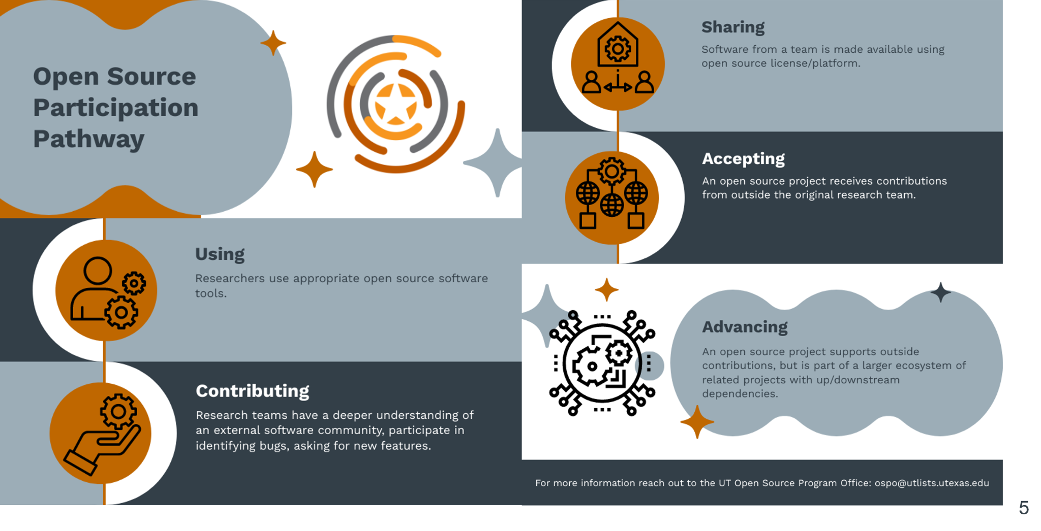

Slide 21
How Can the OSPO Help Researchers?
Training/Events
Funding Identification
Best practices guides
Consultation Services

Slide 22
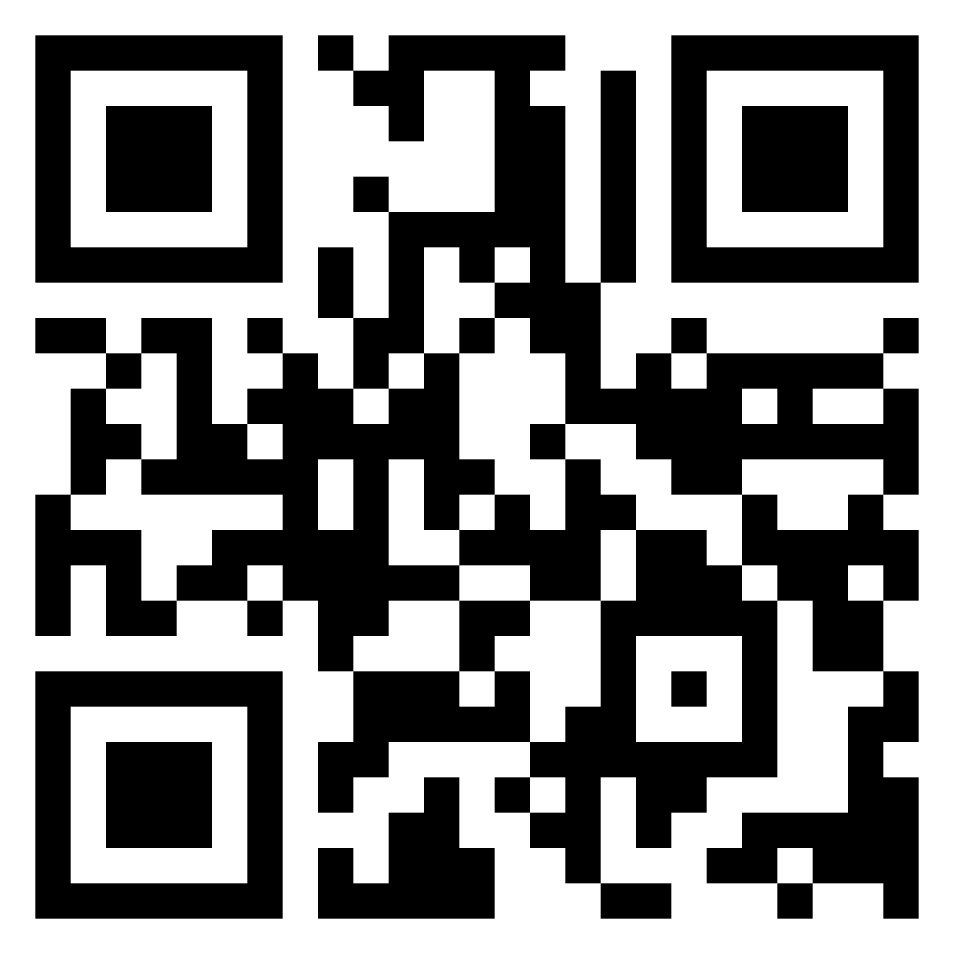
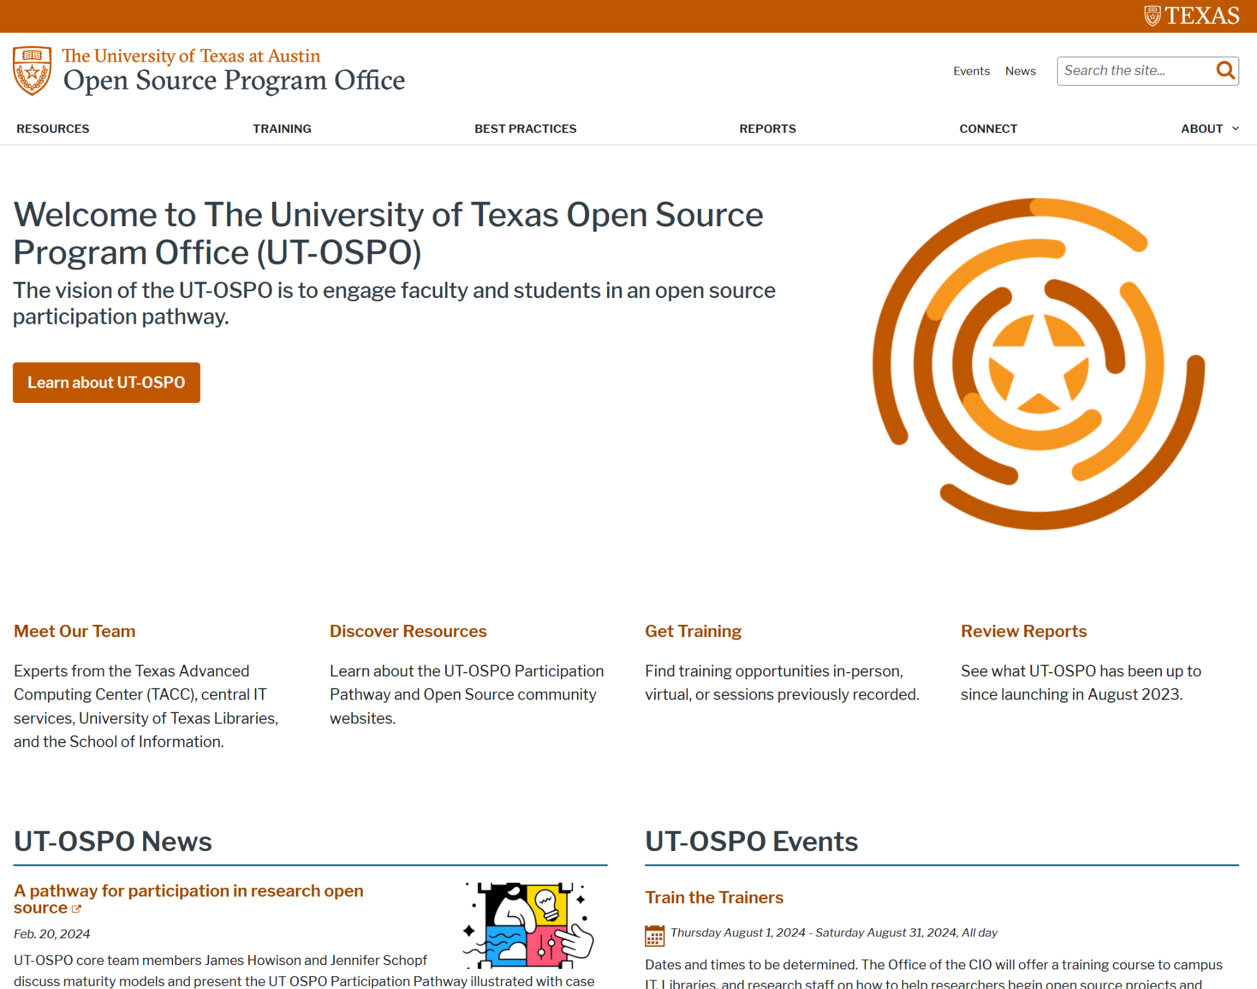
How to Connect
Contact us at: ospo@utlists.utexas.edu
Visit our website: www.opensource.utexas.edu (or us QR code below)
Sign up to receive emails: https://utlists.utexas.edu/sympa/subscribe/ospo.announce
Book a consultation: https://outlook.office365.com/book/UTOSPOOpenSourceSoftwareConsultation@utexas.onmicrosoft.com/

Slide 23

Upcoming Spring Workshops & Events
What Workshops covering research data practices and software
When On the following dates: 1/31, 2/11, 2/12, 2/13, 2/14, and 2/28
Time 12pm - 1:15pm
Where Zoom (all dates) / PCL Scholars Lab (select dates)
More info https://guides.lib.utexas.edu/data-and-donuts
Data & Donuts Workshop Series
What Comprehensive introduction to key UT research computing resources
When Fri. April 4th 2025, 10am - 12pm
Where PCL Scholars Lab
Research Computing Resource Fair

Slide 24
Workshop Wrap Up
Thank you for attending!
Any questions?
Please provide Day 2 feedback in the shared notes document at https://bit.ly/ipw-jan2025

